Slide 1
Scientific collaboration in Russian universities before and after the excellence initiative Project 5-100
Nataliya Matveeva
Anuška Ferligoj
March 19, Moscow, Russia
Notes:
1

Slide 2
Government university excellence initiatives across the world
Stimulate and regulate the educational and research activities in universities (Altbach & Salmi, 2011)
Enhance a research activity (Shin, 2009; Turko et al, 2016; Zhang, Patton, & Kenney, 2013)
Induce scientific collaborations with other organizations, including foreign ones (Yonezawa & Shimmi, 2015; Möller, Schmidt & Hornbostel, 2016; Guskov et al, 2018; Matveeva, Sterligov & Yudkevich, 2019)
Have also influence on collaborations patterns of universities

Slide 3
Russian case – the project “5-100”
- was launched in May 2013 to improve the competitive position and visibility of a group of leading Russian universities at the global academic market
- includes 21 universities (15 universities from 2013 and 6 from 2015)
- provides funds on a competitive basis with permanent monitoring of short-term achievements
- key indicators include number of peer-reviewed publications and citations per capita
Has a significant impact on the publication activity of participating universities (Turko T et al., 2016, Poldin et al., 2017, Agasisti et al, 2018; Matveeva, Sterligov & Yudkevich, 2019 )

Slide 4
Project “5-100” and scientific collaboration
Participating universities have significantly increased the number of publications written in collaboration with Russian Academy of Sciences (Ivanov et al, 2016; Mazov & Gureev 2017)
Universities changed their publication strategies in favor of increasing the number of publications (Guskov et al, 2018)
Since 2013 the number of author affiliations and share of papers written in collaboration with other organizations have increased (Matveeva, Sterligov & Yudkevich, 2019)
the Project stimulate participating universities to intensified their collaborations with other organizations

Slide 5
Our study
What is the structure of collaboration in 5-100 universities?
How it changed after the start of 5-100 Project?
We analyze dynamics of affiliations and the co-authorship networks of Russian universities before and after Project 5-100
We investigate the rate of collaboration with other organizations, position of universities in the academic network and the structure of collaborations between the participants

Slide 6
Background: Co-authorship network
Co-authorship - observed form of scientific collaboration
Co-authorship network – graph constructed based on publications. Nodes are scientists or organizations, links – publications
Types of networks: (un)weighted,(un)directed
Analysis of co-authorship networks allows:
To investigate the principles of knowledge distribution (Newman 2004)
To specificity trends of collaboration in various scientific disciplines (Fafchamps et al. 2010; Matveeva & Poldin 2016),
To reveal correlation between the position of scientists in network and their efficiency expressed in citation (Abbasi et al. 2011; Badar et al. 2015)
To study the stability of clusters of co-authorship network in time (Cugmas, DeLay, Žiberna & Ferligoj 2019)

Slide 7
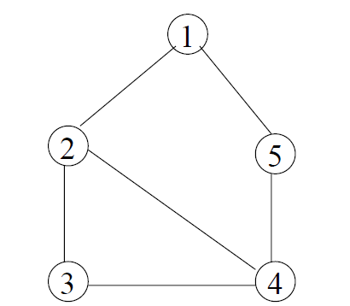
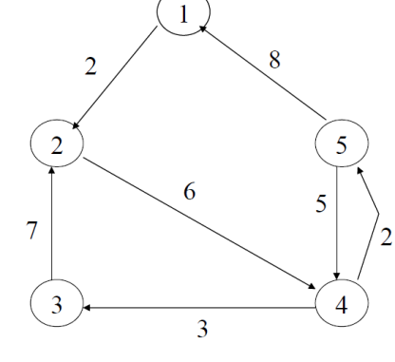
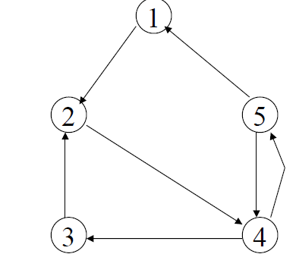
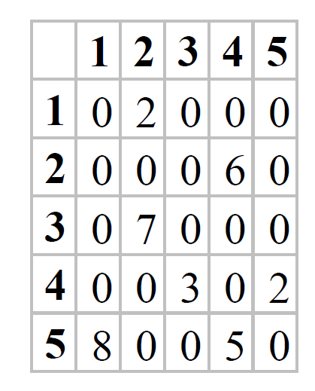
Background: Examples
Co-author network is a graph in which authors of publications are nodes and their joint publications are links
Adjacency matrix for (3)
(1)Undirected
(2)Directed
(3)Weighted and directed

Slide 8
Background: Characteristics of the network
Diameter - maximum distance between any pairs of nodes
Mean distance characterizes the distance between the network participants
Density - the proportion of available links
Average degree centrality - average number of the universities with which a university has joint publications

Slide 9
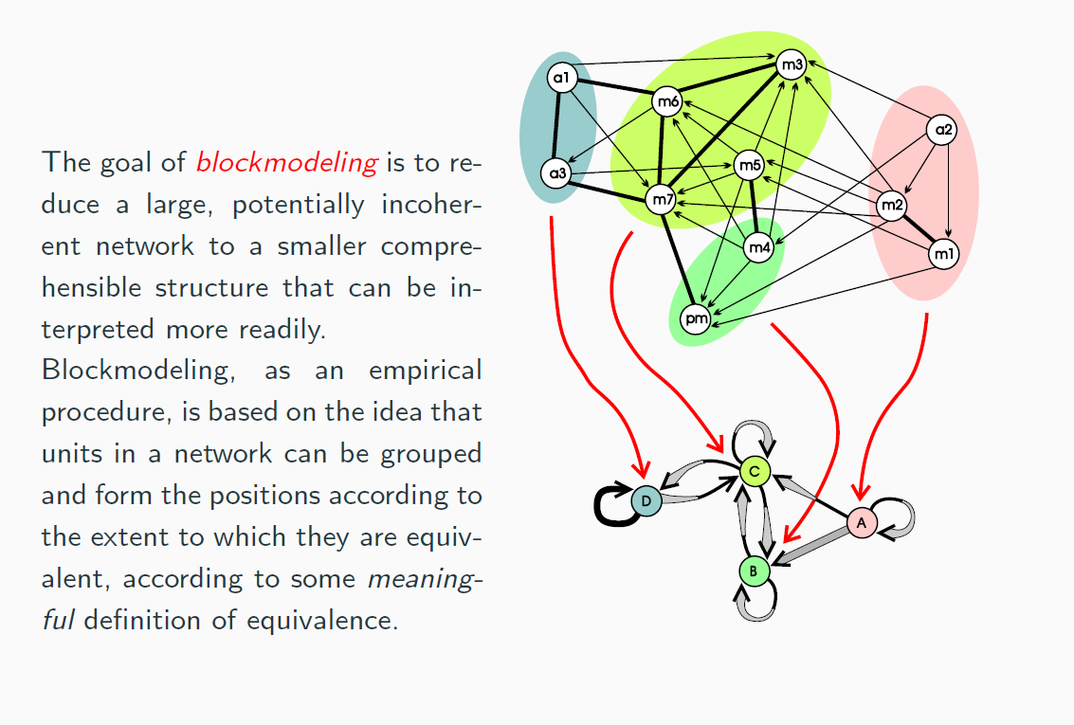
Background: Blockmodeling
Doreian, P., Batagelj, V., & Ferligoj, A. (2005). Generalized blockmodeling (Vol. 25). Cambridge university press

Slide 10
Data
Treatment group: 15 universities which participate in Project 5-100 since 2013
Control group: 15 Russian universities that at the beginning of the project had comparable key indicators of research intensity with the treatment group
total number of articles and reviews from 2010 to 2016 years attributed to universities' profiles in WoS (indexes SCIE and SSCI)
number of publications in the journals of the highest (Q1) and the lowest (Q4) quartiles according to their JIF

Slide 11
Methods
Analysis of affiliations
to investigate the rates of collaborations with other organizations, domestic and international cooperation
Co-authorship network analysis including blockmodeling procedure (Doreian,Batagelj & Ferligoj, 2005)
to detect the position of universities in the academic network and the structure of collaborations between universities

Slide 12
Procedure
From each publication were extracted:
information about the authors’ affiliations
the number of co-authors
the year of publication
the ISSN (International Standard Serial Number) of the journal was extracted. ISSN was used to obtain the JIF for each year.
Two types of co-authorship networks were constructed:
1) includes all universities and organizations which are mentioned in the publications of 30 universities and RAS
2) consists of only 30 universities

Slide 13
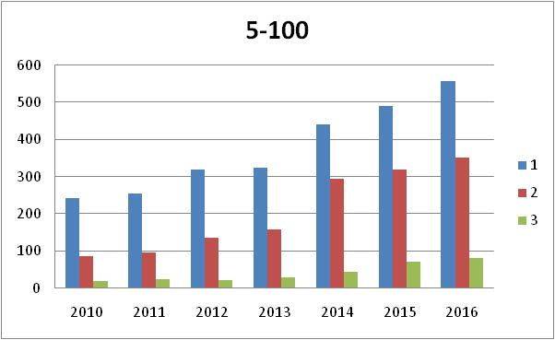
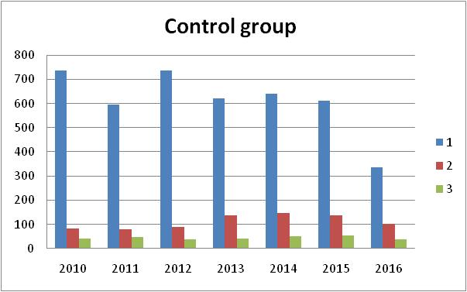
Number of publications with one author and 1 to 3 affiliations
in both group more often one author has one affiliation
-in 5-100 universities the number of solo publications with 2 and 3 affiliations has become much higher than in the control group since 2014

Slide 14
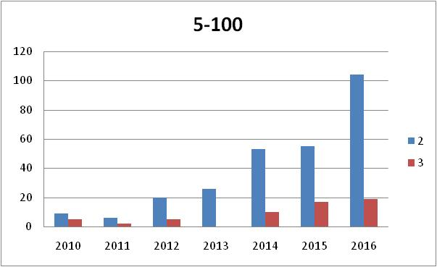
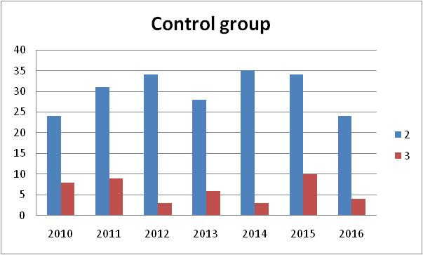
Number of publications with one author and 2-3 affiliations one of which is foreign
From 2013 to 2016 5-100 universities increased in three time number of solo publications, written in co-authorship with foreign organizations
In control group the number of solo publications with foreign has changed slightly

Slide 15
Number of publications written in collaboration with other organizations
 |  | 2010 | 2011 | 2012 | 2013 | 2014 | 2015 | 2016
With Russian organizations without RAS | 5-100 | 1187 | 1275 | 1481 | 1679 | 2085 | 2742 | 2879
 | Control group | 2520 | 2418 | 2591 | 2511 | 2704 | 3235 | 2058
With foreign organizations without RAS | 5-100 | 473 | 565 | 709 | 957 | 1577 | 2897 | 2897
 | Control group | 1378 | 1386 | 1456 | 1540 | 1683 | 1914 | 1216
With RAS without foreign | 5-100 | 934 | 1171 | 1225 | 1656 | 2352 | 3350 | 3594
 | Control group | 1044 | 1138 | 1233 | 1306 | 1521 | 1830 | 1139
Before starting the project both groups of universities have more join works with other Russian organizations than with foreign and RAS
Since 2013 in 5-100 universities the number of join publications with RAS and foreign organizations has become more than with Russian organizations

Slide 16
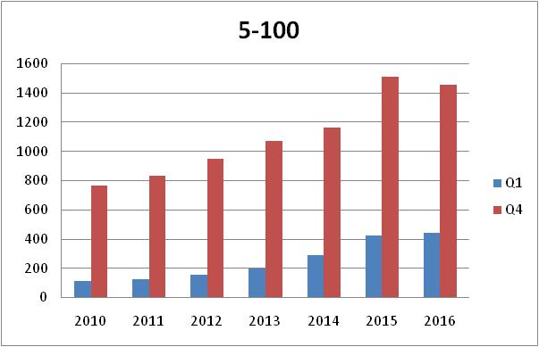
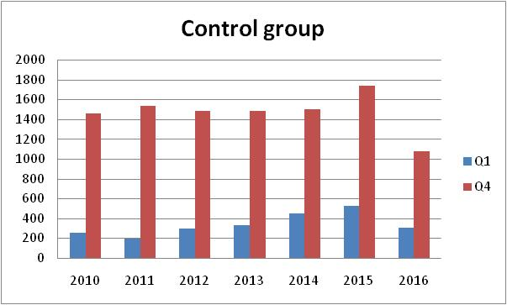
Quality difference: Q4 prevalence in domestic collaboration
Number of Q1 and Q4 publications written in collaboration with Russian organizations
In both group collaborations with other Russian organizations is higher in Q4 than Q1
Although in 5-100 universities the number of Q1 publications has twice increased since 2013 to 2016

Slide 17
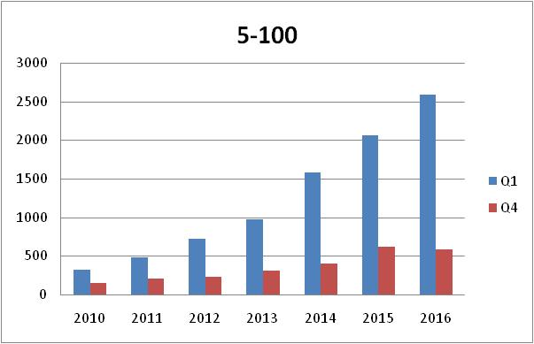
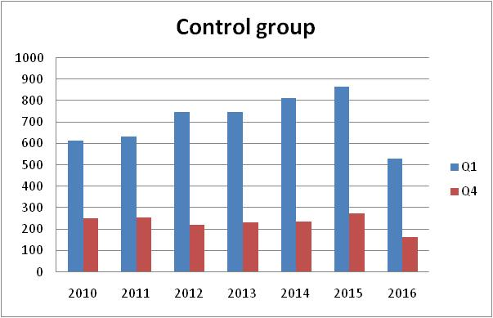
Quality difference: international collaboration is prolific for Q1-output
Number of Q1 and Q4 publications written in collaboration with foreign institutions
In both universities groups Q1-publications prevail
In 5-100 universities number of Q1 publications written in co-authorship with foreign organizations increase during all period

Slide 18
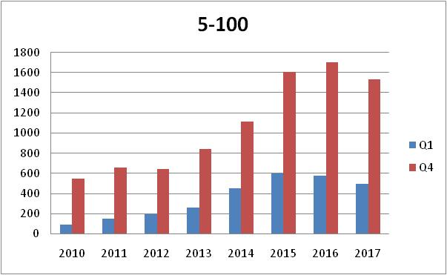
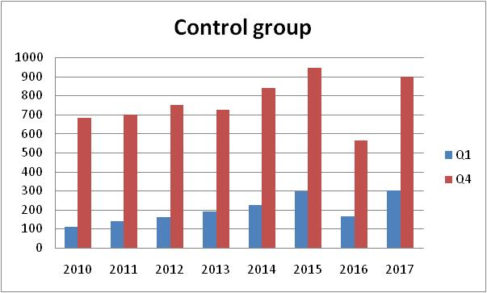
Quality difference: growth quality in collaboration with RAS
Number of Q1 and Q4 publications written in collaboration with RAS
Q4 –output prevails in both groups
since 2014 5-100 universities increased collaborations with RAS in Q4 segment
- at the same time, from 2014 to 2016 in universities 5-100 number of Q1 publications with RAS doubled

Slide 19
Co-authorship network of Russian universities
 | 2010 | 2011 | 2012 | 2013 | 2014 | 2015 | 2016
Number of scientific organizations | 2217 | 2302 | 2371 | 2632 | 2820 | 2954 | 2642
Number of publications | 1156294 | 3137752 | 6219419 | 4847998 | 5112911 | 6325811 | 7257623
Diameter | 7 | 6 | 6 | 6 | 5 | 5 | 5
Mean distance | 2.53 | 2.53 | 2.41 | 2.50 | 2.41 | 2.35 | 2.22
Link density | 0.079 | 0.215 | 0.427 | 0.333 | 0.351 | 0.434 | 0.498
Average degree centrality | 425.44 | 1159.56 | 2301.17 | 1792.89 | 1890.95 | 2339.83 | 2685.33
- for six years this network has significantly replenished
- the number of links has increased to a greater extent than the number of nodes and the edge density has increased, so universities have also collaborate with those who are already members of the network
- in 2016 the co-authorship network of 30 Russian universities become more dense and coupled than in previous years: the number of scientific organizations has decreased, although the number of their join publications has increased

Slide 20
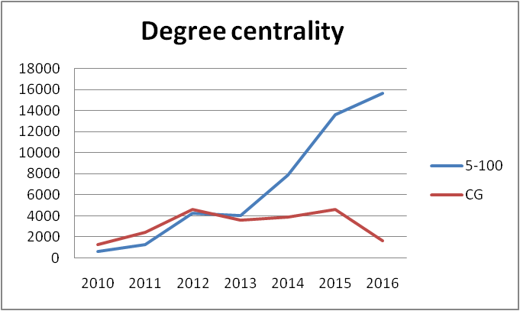
Degree centralities of two universities groups
Degree centrality - the number of scientific organizations with whom universities have join publications. It has significantly increased since 2013 in universities 5-100

Slide 21
The increase of the degree centrality by universities from 2010 to 2016

Slide 22
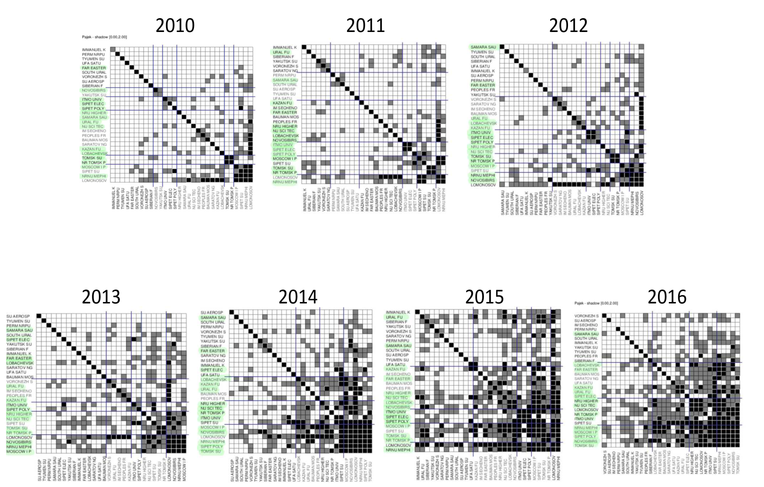
Blockmodel structure of 30 Russian universities from 2010 to 2016

Slide 23
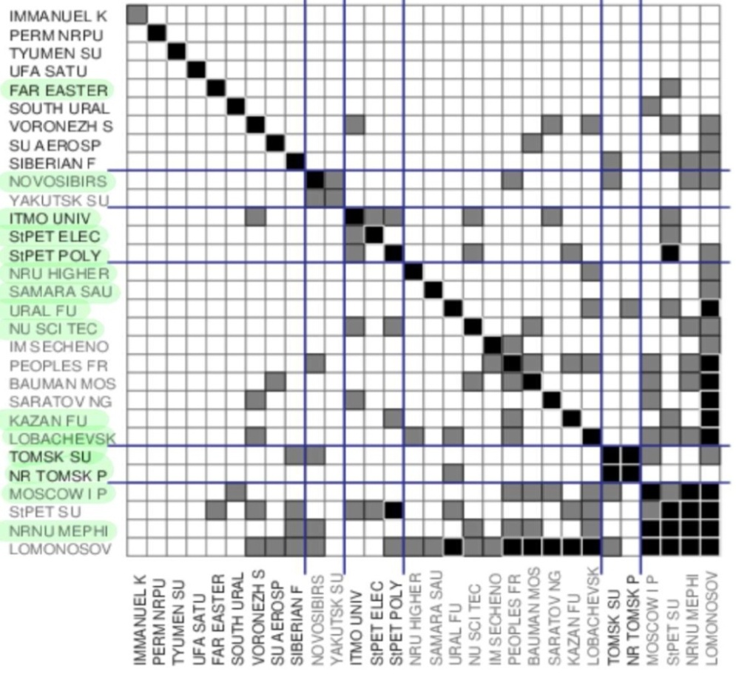
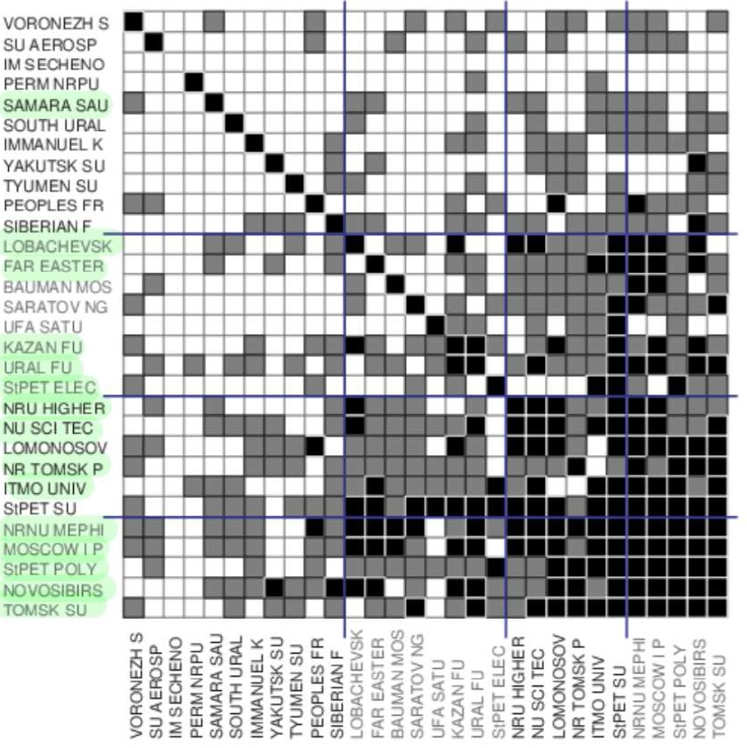
Matrixes in 2010 and 2016

Slide 24
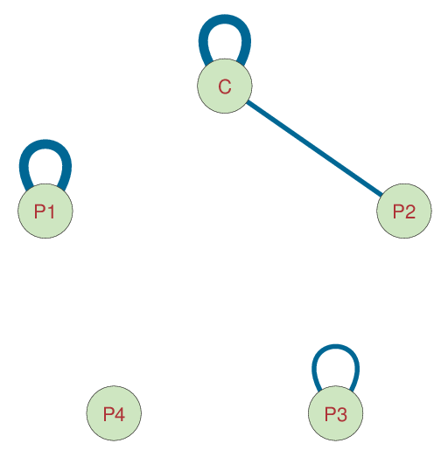
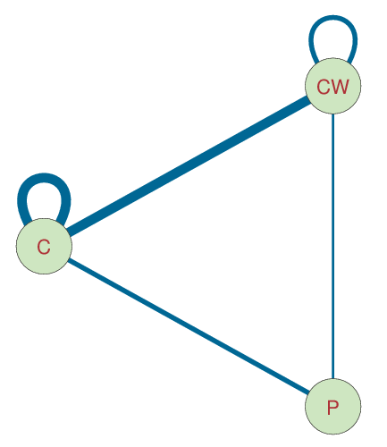
Blockmodels for 2010 (left) and 2016 (right)
C – strongly connected cluster, CW – weaker core cluster, P- peripheral clusters

Slide 25
Findings
Since 2014 in 5-100 universities there is a growth of publications prepared in collaboration with other organizations
Collaborations between universities in particular are in one person
Until 2013 inclusive in 5-100 universities prevailed cooperation with Russian universities and since 2014 number of papers written in collaboration with RAS increased as well
5-100 universities intensified collaborations with other organization in both Q1 and Q4 segments
In Q1 segment 5-100 universities more often collaborate with foreign institutions than with Russian and RAS
Collaborations patterns of non-participating universities haven't changed significantly

Slide 26
Findings
Participating universities enhanced their positions in the co-authorship network
The most part of 5-100 universities has increased their positions in co-authorship network. And the rate of growth in this group is more homogeneous than in the control group
After the Project starting 5-100 and control group universities have also increased collaborations with each other
Although participation in the Project stimulated universities intensified collaboration with each other in greater degree than with other Russian universities

Slide 27
Discussion
Co-authorship doesn't reflect all collaboration between scholars
The analyzed collaboration limited by publications’ sample
There is a question about the stability of the intense scientific collaboration when Project 5-100 will be finished, as there are considerable financial costs connected to scientific collaboration

Slide 28
The sample
Treatment group
Far Eastern Federal University (FEFU)
Kazan Federal University (KFU)
Moscow Institute of Physics and Technology (MIPT),
National University of Science & Technology (MISIS)
National Research University Higher School of Economics (HSE)
National Research Tomsk State University (TSU)
National Research Tomsk Polytechnic University (TPU)
National Research Nuclear University (MEPhI)
Lobachevsky State University of Nizhny Novgorod (UNN)
Novosibirsk State University (NSU)
Samara National Research University (SSAU)
St. Petersburg State Polytechnical University (SPbGPU)
St. Petersburg State Electrotechnical University (LETI)
St. Petersburg State University of Information Technologies (ITMO)
Ural Federal University (UFU)
Control group
Baltic Federal University (BFU)
North-Eastern Federal University in Yakutsk (NEFU)
Peoples Friendship University of Russia (RUDN)
Siberian Federal University (SibFU)
Tyumen State University (TyUU)
South Ural State University (SUSU)
Moscow Aviation Institute (MAI)
Perm National Research Polytechnic University (PGTU)
Saratov State University (SSU)
Southern Federal University (SFU)
Bauman Moscow State Technical University (MSTU),
Voronezh State University (VSU)
Ufa State Aviation Technical University (UGATU)
Moscow State University (MSU)
St. Petersburg state University (SPbGPU)

